Slide 1
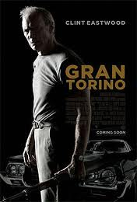
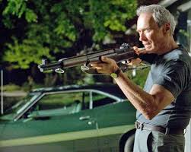

FILM STUDY 3AB: GRAN TORINO and SHAWSHANK REDEPMTION SEMINAR

Slide 2
SYNOPSIS OF FILM
Gran Torino is a 2008 movie directed by Clint Eastwood about a widowed war veteran Walt Kowalski, who despite initial racism becomes a father figure to his Hmong neighbour Thao. Walk ultimately saves his community from a violent gang by laying down his life.
Shaw shank Redemption is a 1994 film directed by Frank Darebin about the unfair conviction of innocent Andy Duffrese to prison and his life and eventual escape from the prison.

Slide 3
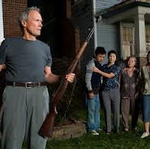
SEMINAR QUESTION
EXPLORE THE IDEA OF REDEMPTION IN THE FILMS STUDIED AND ITS IMPACT ON THE CONSTRUCTION OF IDENTITY

Slide 4
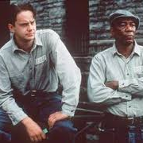
WHAT IS REDEMPTION and IDENTITY?
REDEMPTION- deliverance from sin and atonement for guilt which brings about salvation by atoning for faults and mistakes.
IDENTITY refers to sense of self as distinct from others and is shaped by the culture and context impacting an individual.
Through redemption the identity of the protagonists is established as Christ-figures.

Slide 5
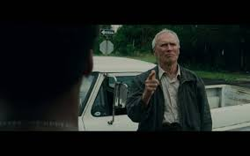
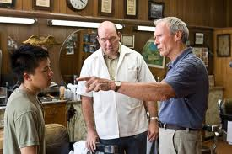
Walt’s Identity
War Veteran (Korean war)
Part of silent generation
Ford factory worker
Age ( around 85+)
White American (polish descent)
Christ-figure
Patriarch
Masculinity
Christianity- Catholic

Slide 6
Andy Duffrese
Age- young
White American
Christ-figure
Patriarch
Educated banker
Christianity
NOT a typical masculine gender role eg. Doesn’t swear, doesn’t use violence except in self defence, quiet

Slide 7
Christ-Like Figures
convicted yet innocent ( like Jesus Christ)
White American
No conversion
Baptised like Christ by rain.
Isolated figure (in beginning) shown through his higher education as set apart and different from other prisoners i.e.. he doesn't swear
redeemed his friends and himself a new life
Doesn't use violence
Willingly sacrificed himself
White American
Reconciliation and forgiveness of individual
Crucifix symbol when he died
Isolated figure, set apart and different from society like Christ.
Saved the community from gang, so redeemed Sue’s honour and his past sins.
Uses violence to challenge
Has a disciple
ANDY DUFFRESE
WALK KOWALSKI

Slide 8

AMERCIA”S IDENTITY
power
ideal
ordered
youth vs. infirm
multicultural
Walt represents the “old American” way of hard work
America shown as Christian
Belief in God
Slowly crumpling from great nation (neighbourhood in disrepair)
Walt’s family is identified as lowering standards, materialistic and spoilt a symbol of America.

Slide 9
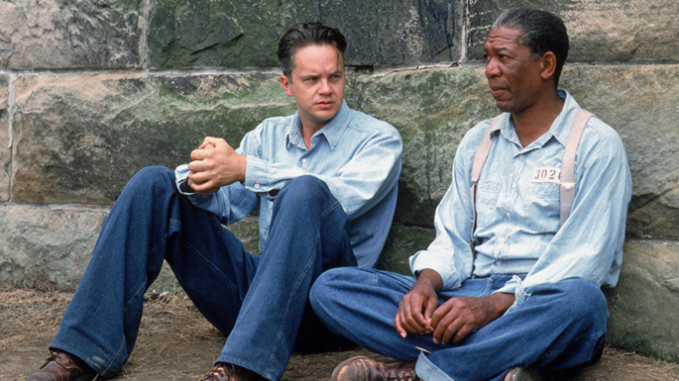
Disciples
Both films have “followers” or “supporters” of the Saviors
These characters are friends and pupils learning from the “superior” Saviour
Disciples are dependent on a Saviour
Lower status
Jesus Christ had twelve disciples

Slide 10
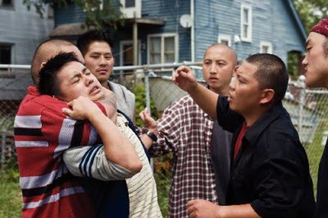
ThaO's Identity
disciple
Hmong
Feminine
Dependent on saviour
powerless
Thao provides a redemption of fatherhood to Walt in his mentoring
Thao redeems Walt’s purpose in life, sense of happiness and fulfilment in passing on his legacy

Slide 11
Recipients of redemption
Feminine qualities
Harassed by gang
Needs role male model
committed sin ( stealing car)
Hmong ethnic background (lower status)
Disciple
helps his Saviour
needs hope
committed sin (murder)
Afro-American Background ( weaker status ethnically)
Disciples
provides education, leaves a legacy
His Saviour needs no help
Thao Lor
“RED” Ellis Boyd Reading and Williams

Slide 12
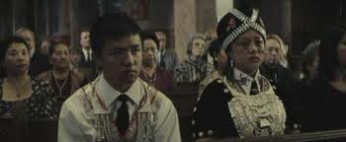
hMONG Identity
Either passive and dependent on saviour OR counter part is corrupt
In car with Sue Walt provides a father-figure showing Hmong rely on guidance, stability and pathways to safety through hegemonic
Hmong are seen as family orientated, patriarchal males as leaders, peaceful, downtrodden by community.

Slide 13
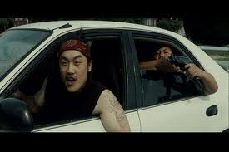
Question: Why did clint eastwood use hmong culture?

Slide 14
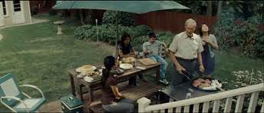
ANSWER:
1.) less known culture, so possibly to educate and create awareness
2.) Involved in Korean War so the culture has a direct link to Walt’s character.
3.) Other ethnic groups such as Afro- Americans and Hispanics are more insistent on rights may have been offended with all the epithets of racism.
4.) Seen as a less dominant and weaker culture to America.

Slide 15
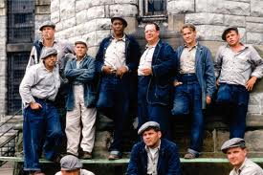
REDEMPTION how it constructs identity
The films Gran Torino and Shaw shank Redemption both deal with binary opposition and change throughout the film. Such as the identity change of institutionalised Red to freeman Red. The binary opposition between good vs. bad and life vs. death is a constant theme.

Slide 16
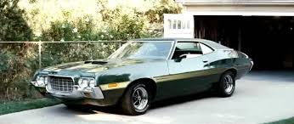
FINAL CONFRONTATION links to Jesus final confrontation- Gran Torino
Walt willingly sacrifices his life and has planned it as his purpose like Christ who knew his mission and life’s purpose was to die.
The garden and night time setting are reminiscent of the garden of Gethsemane just before Christ’s death
- The conflicting leadership is also like that of Biblical Christ where the religious leaders accused him.
-Walt falls into a crucifix position with the blood pouring into palms like the nails of the cross
-Walt resurrects in his Gran Torino which is symbolic of Walt.

Slide 17
Walt’s sacrifice and its impact on identity
At Walt’s funeral, the Hmong Lor family children (sue and Thao) wear traditional dress showing they have come back from American standards and respect their country. It shows Walt’s redemption of their community allows them to walk with pride in their nationality without fear.
The Priest is changed and is more respectful to Walt due to his sacrifice. His identity is now more perceptive of other’s opinions as he voices Walt’s true opinion of him at the funeral.ie. Walt had no problem telling it as it is.

Slide 18
Crucifixion and resurrection
symbolically comes to new life when he comes out of sewer
Rain wash's away sins and the old life, to a new life where he is reborn a free man
Resurrects as a free man into glory
Seen in “clouds” when Red sees him and wears white showing his new life
Sacrifices life
Symbolically resurrects through car( Gran Torino represents Walt)
Like Christ he leaves his legacy through his disciple Thao i.e. the instilled work ethic and masculinity values.
Hmong community allowed to be proud about identity without fear
Walt Kowalski
Andy Duffrese

Slide 19
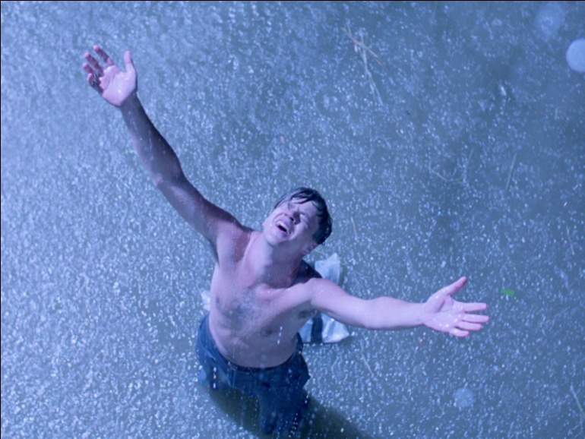
SUMMARY
Walt and Andy through redeeming themselves and others are identified as Christ figures
The recipients of redemption are shown to be identified as disciples
The American culture is shown to be dominant and be the saviour and able to redeem other countries
Hmong culture is seen as dependent and weaker in need of America as a Saviour
Like Christ both Christ figures “resurrect” changing the world for the better through this i.e.. Andy leaves the prison in better condition and Walt’s legacy lives on in Thai

Slide 20

THE END☺

